Slide 1


Immigration Seminar for Living and Thriving in Louisville
Event Hosts
Sponsor: Greater Louisville Inc. World Affairs Council of Kentucky and Southern Indiana, World Trade Center of Kentucky,
Crane House, Vietnamese Community, Indian Community Foundation of Louisville and Prospanica
Notes:
-Event Hosts: Bluegrass International Fund and Wyatt Tarrant & Combs
-Sponsor: Greater Louisville Inc. World Affairs Council of Kentucky and Southern Indiana, World Trade Center of Kentucky, Crane House, Vietnamese Community, Indian Community Foundation of Louisville and Prospanica

Slide 2
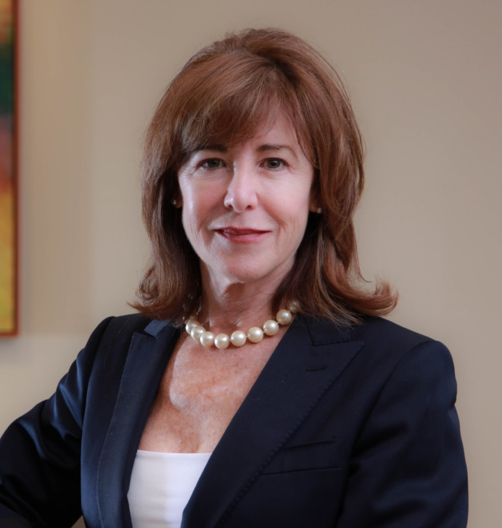
Bluegrass International Fund
CEO & President: Lynn Allen
Ms. Allen has devoted her career to raising capital to create jobs and expand educational opportunities both in the US and overseas.
-She has led regional, national and multi-country marketing teams that produced millions of dollars in new revenues for economic development initiatives.
-Capital Innovations (Founder)
-CARE International(Director of International Corporate Initiatives)
Current involvement:
-Board member, Kentucky Association of Economic Development
-Board member, Purdue University’s Emerging Innovation Fund
-Board member, World Affairs Council of Kentucky and Southern Indiana
-Member, IIUSA EB-5 Industry’s National Association Public Policy Committee
Notes:
Wit reads the bio:
Ms. Allen has devoted her career to raising capital to create jobs and expand educational opportunities both in the US and overseas. She has led regional, national and multi-country marketing teams that produced millions of dollars in new revenues for economic development initiatives.
In 2003 she formed Capital Innovations, a strategic advisory firm that works with public/private stakeholders to raise capital for private equity funds that invest in high-growth-potential companies. Prior to forming Capital Innovations, Ms. Allen served as director of Institutional Marketing at AEGON USA where she uncovered 529 college savings plans as a major new market opportunity.
For 10 years, she served as CARE International’s Director of International Corporate Initiatives where she forged CARE’s first strategic partnerships with global corporations. A native of Vine Grove, Kentucky, Ms. Allen is a board member of the Kentucky Association of Economic Development, an advisory board member of Purdue University’s Emerging Innovations Fund, a board member of World Affairs Council of Kentucky and Southern Indiana, and a member of the Public Policy Committee of the EB-5 industry’s national association, IIUSA.

Slide 3
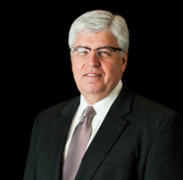
Wyatt Tarrant & Combs LLP
Immigration Counsel: Glen M. Krebs
Glen M. Krebs is a member of the International Trade and Labor and Employment Practice Groups at Wyatt, Tarrant & Combs, LLP.
-Practice focused on international and immigration law since 1990
-Represented clients from 65 countries, including China, Japan, Russia, Canada, Ghana and Bulgaria
-Speaks fluent Japanese and has assisted more than 40 Japanese companies in the US
Community involvement:
-American Immigration Lawyer Association
-Fayette County, Kentucky and American Bar Association
-Past Chairman, Japan/America Society of Kentucky
-Past Treasurer, National Association of Japan America Societies
-Former Board member and Chair, World Trade Center
-Former Board member and Chair, Lexington Sister Cities Commission
Notes:
Wit reads the bio:
Glen M. Krebs is a member of the International Trade and Labor and Employment Practice Groups at Wyatt, Tarrant & Combs, LLP. He concentrates his practice in international and immigration law.
Before joining Wyatt, Tarrant & Combs, LLP, Mr. Krebs was a solo practitioner. He has appeared on behalf of clients at U.S. embassies in China, Japan, Russia, Canada, Ghana and Bulgaria. He has represented clients from more than 65 different countries. Mr. Krebs has been recognized for immigration law in The Best Lawyers in America since 1990. He speaks fluent Japanese and has assisted more than 40 Japanese companies establish their presence in the United States. Mr. Krebs has written and spoken extensively on the subject of Doing Business with the Japanese and on Immigration Law.
He served as Chairman of the Japan/America Society of Kentucky for six years and as Treasurer for the National Association of Japan America Societies for three years. He also chaired the World Trade Center of Kentucky Board of Directors, and the Lexington Sister Cities Commission. Mr. Krebs is a member of the Fayette County, Kentucky and American Bar Associations, as well as the State Bar of California. He has been active in the American Immigration Lawyers Association for 25 years.

Slide 4

Overview
Work Visas
Family Visas
EB-5 Investment Visa
Q&A

Slide 5

Work-Eligible Visas
F-1/J-1
  Duration: based on completion of the degree
  Study-based exchange program
H1-B Temporary Work Visa
  Duration: 6-year(3,3)
  Quota: 65,000 with additional 20,000 for U.S. Master’s degree or higher
L-1 Intra-Company Transferees
  Duration: L1A – 7 years; L1B – 5 years
  Company-specific restriction

Slide 6

Work Visas
First Preference (EB-1)
  Extraordinary Ability, Outstanding Researcher, Multinational Executive
Second Preference (EB-2)
  Advanced Degree Professionals( Bachelors plus 5 years experience), Aliens of Exceptional Ability
Third Preference (EB-3)
  Skilled Worker (2+ years experience), Bachelor’s Degree

Slide 7

Family Visas
Family Preference Immigration Visas
  First Preference (F1): unmarried sons and daughters
  Second Preference (F2): spouses, minor children, and unmarried sons and daughters over 21 years of age
  Third Preference (F3): married sons and daughters and their spouse
  Fourth Preference (F4): brothers and sisters

Slide 8

Family Dependent Visas
J2/F2: dependents of J1/F1exchange scholar and student
H-4: dependents of H workers
L-2: dependent of L1 intracompany transferees

Slide 9

Other Visas
Green Card Lottery
  50,000 visas annually
  15 million applicants in 2015
International Entrepreneur Parole
  5 years (2.5, 2.5)
  Ownership in a start-up entity within the past five years
  Receive significant investment of capital from qualified U.S. investors
  OR receive significant awards or grants for economic development, research and development or job creation

Slide 10
Permanent Residency Bulletin (Filing Date)
Employment Based | All Chargeability Area Except Those Listed | China-Mainland Born | El Salvador Guatemala Honduras | India | Mexico | Philippines
1st | C | C | C | C | C | C
2nd | C | November 2013 | C | February 2009 | C | C
3rd | C | September 2015 | C | January 2008 | C | August 2016
Other Workers | C | June 2008 | C | January 2008 | C | August 2016
4th | C | C | April 2016 | C | C | C
Certain Religious Workers | C | C | April 2016 | C | C | C
5th Regional Center EB-5 Investment Program | C | October 2014 | C | C | C | C
Visa Bulletin for January 2018

Slide 11

EB-5 Investment Visa
Requirements
$500,000 (or $1,000,000) investment
Jobs for 10 Americans
How it works
Return of investment
Annual interest from the invested project
Green Cards for family(applicant, spouse, unmarried children under 21)
Short wait time: 18 months for conditional Green Card, 5 years for permanent Green Card

Slide 12
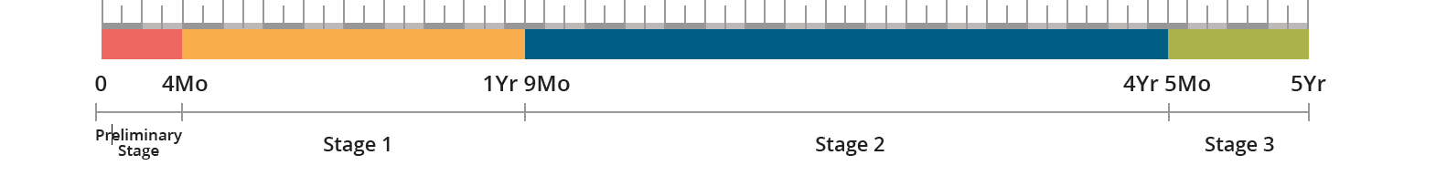
EB-5 Investment Visa Process
Conditional Green Card in hand: 4-6 months
USCIS background check starts: 18-20 months
Job creation approval: 21-24 months
Permanent Green Card in hand: 4-5 months
Investment preparation: 2-4 months

Slide 13

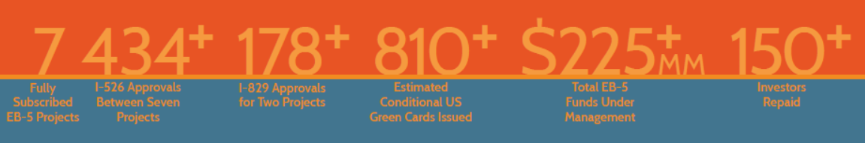
Track Record

Slide 14
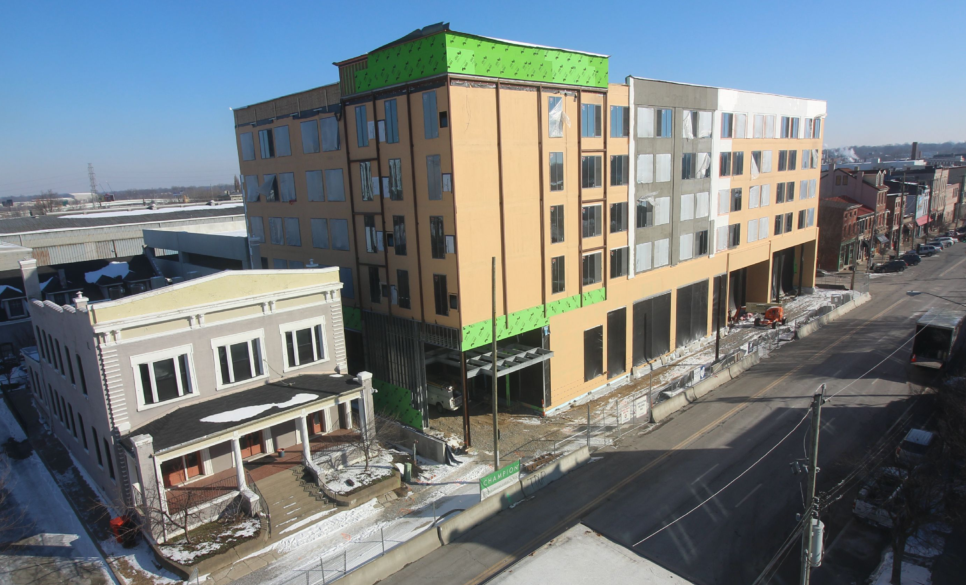

Bluegrass International Fund
Project in Louisville Kentucky:
  AC Marriott Hotel Nulu in downtown Louisville
  $42.9 million USD project with 10 million EB-5 loan
  390 job creation for 20 investors (each investor = 19.6 jobs)
  $500,000 USD investment with 2.5% annual return*
Current Construction
Finished Hotel

Slide 15

Immigration Seminar

Slide 16
Q&A
Bluegrass International Fund
  Wit Wang: wwang@bluegrass-fund.com
  Lynn Allen: lallen@bluegrass-fund.com
  Phone number: 502-583-0160
Wyatt Tarrant & Combs, LLP
  Glen Krebs: gkrebs@wyattfirm.com
  Phone number: 859-288-7409

Slide 17
Hotel Nulu Project Video
Link: https://vimeo.com/240667687

